Slide 1
LVM and RAID based backup

Slide 2
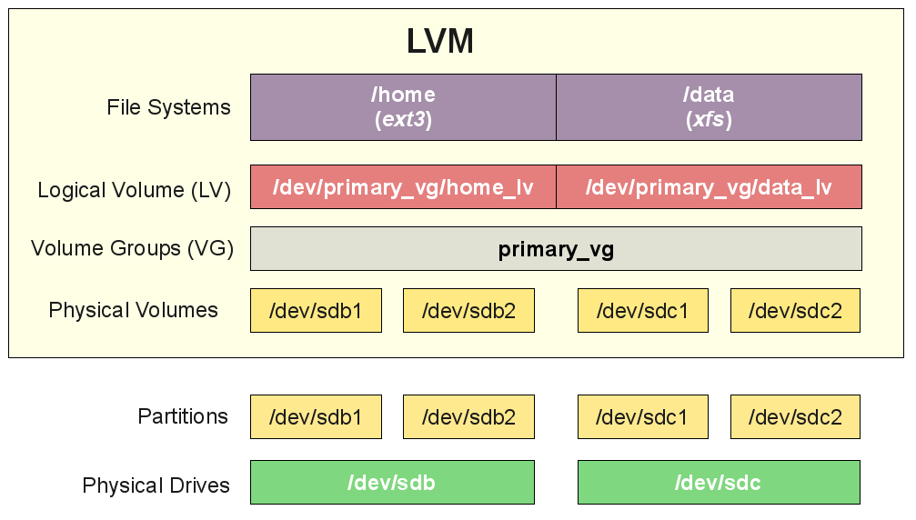
LVM, Logical Volume Manager

Slide 3
/etc/lvm/lvm.conf
# By default we accept every block device:
filter = [ "a/.*/" ]
# Exclude the cdrom drive
# filter = [ "r|/dev/cdrom|" ]

Slide 4
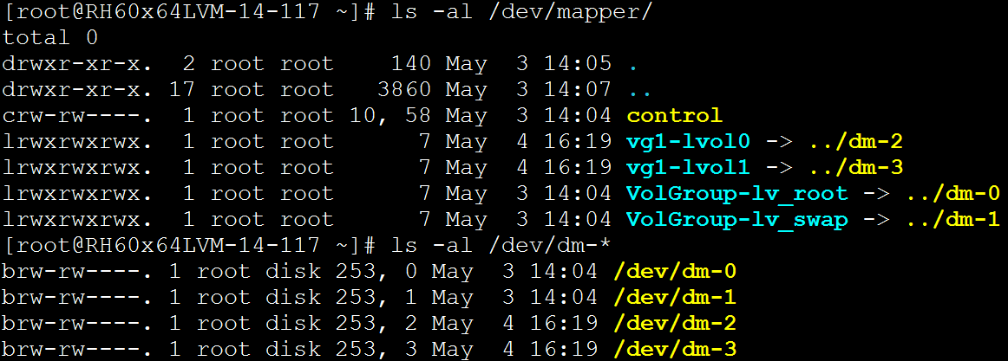
Device-Mapper device

Slide 5
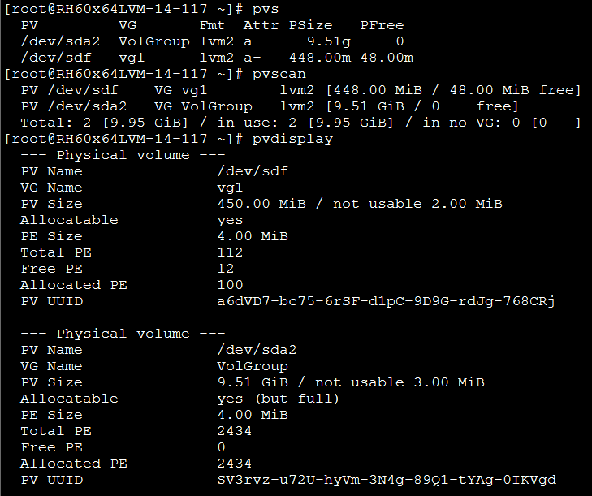
PV basic commands: pvcreate, pvs, pvscan, pvdisplay
pvcreate PhysicalVolume [PhysicalVolume...]

Slide 6
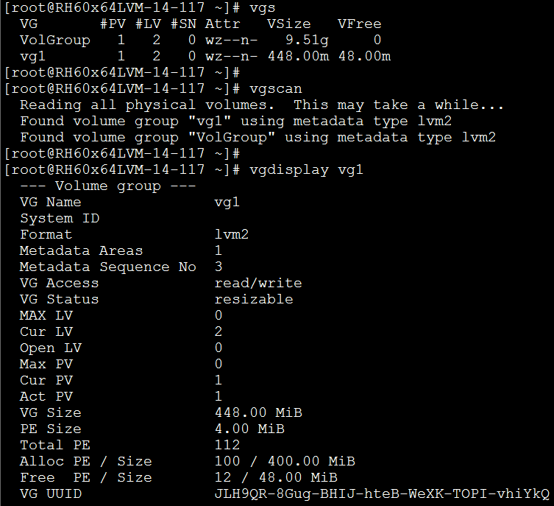
VG basic commands: vgcreate, vgs, vgscan, vgdisplay
vgcreate [-s | PhysicalExtentSize[bBsSkKmMgGtTpPeE]] VolumeGroupName PhysicalDevicePath [PhysicalDevicePath...]

Slide 7
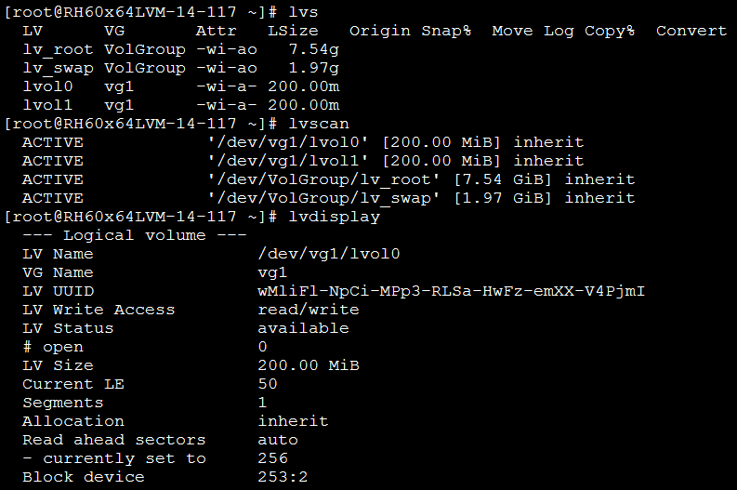
LV basic commands: lvcreate, lvs, lvscan, lvdisplay
lvcreate { -l LogicalExtentsNumber[%{VG|FREE|ORIGIN}] | -L LogicalVolumeSize[bBsSkKmMgGtTpPeE] } [ -n LogicalVolumeName ] VolumeGroupName [PhysicalVolumePath...]

Slide 8
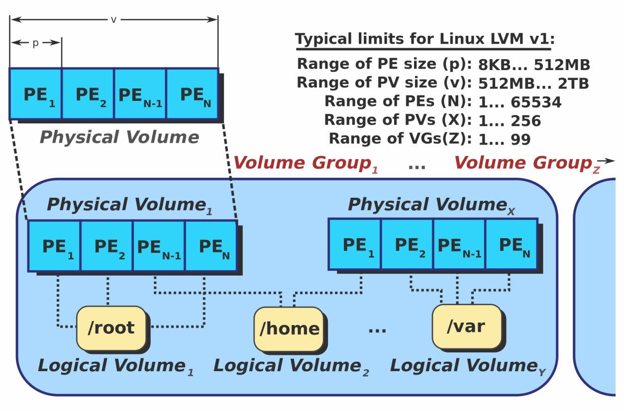
LVM limitation
PE (physical extent)
Maxium PE numbers: (2^16 = 65536)
Default PE size: 4 MB
vgcreate -s 8m vg1 /dev/sdd1

Slide 9


LVM Extend
pvcreate
vgextend
lvextend {-l|--extents | -L|--size [+] …}
resize2fs

Slide 10

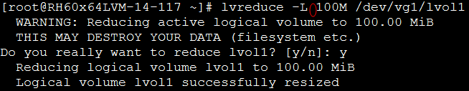
LVM Shrink
unmount
e2fsck
resize2fs
lvreduce {-l|--extents | -L|--size [-] …}
vgreduce (check PV for free PE first, pvdisplay & pvmove)

Slide 11
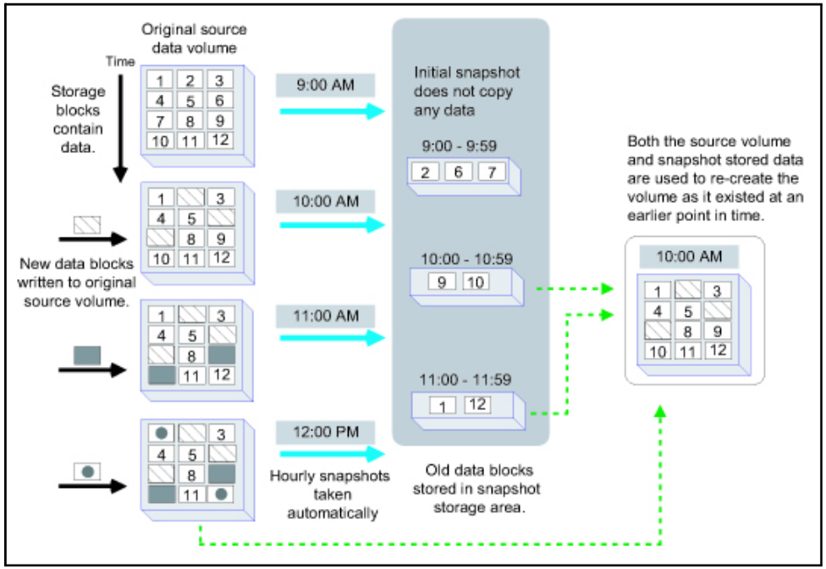
LVM Snapshot
Copy-on-write (COW)

Slide 12
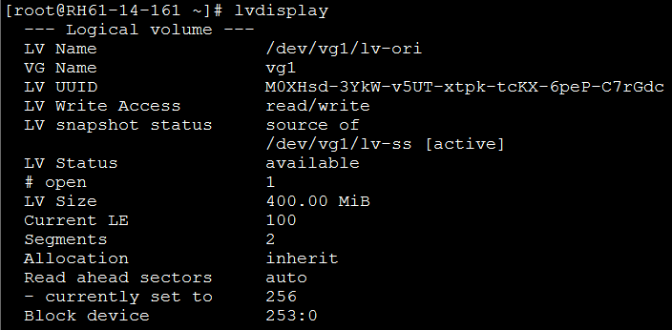
Create LV snapshot
lvcreate –L size –s –n snapshot-name LV-path
#modprobe dm-snapshot

Slide 13
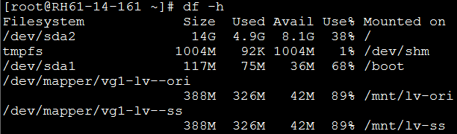
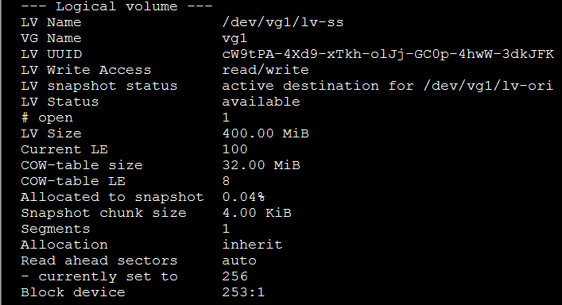
Create LV snapshot cont.

Slide 14
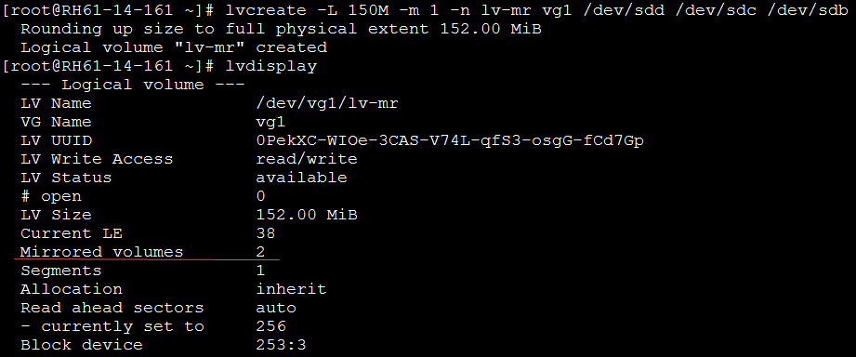
Create LVM Mirror
lvcreate -L 150M -m 1 -n lv-mr vg1 /dev/sdd /dev/sdc /dev/sdb
-m 1: 2 mirror-leg PV disks
mirror-log

Slide 15
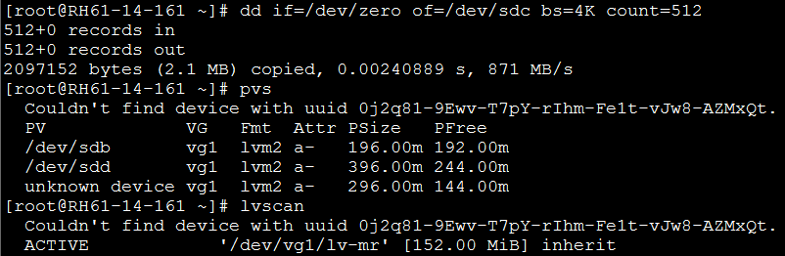
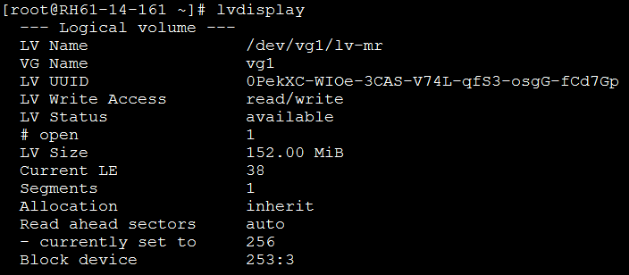
Exam to remove PV
dd if=/dev/zero of=/dev/sdc bs=4K count=512
vgreduce --removemissing --force vg1

Slide 16
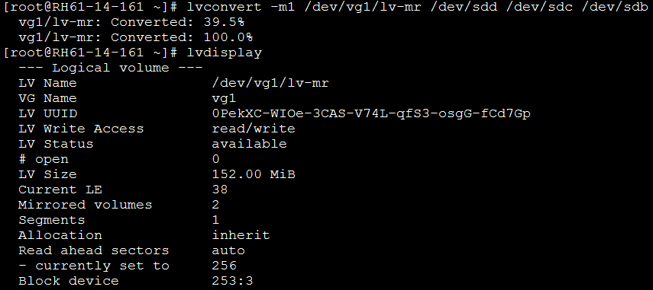
Repair LVM Mirror
pvcreate /dev/sdc
vgextend vg1 /dev/sdc
lvconvert -m1 /dev/vg1/lv-mr /dev/sdd /dev/sdc /dev/sdb

Slide 17
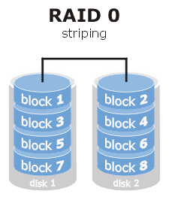
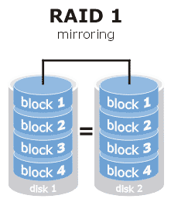
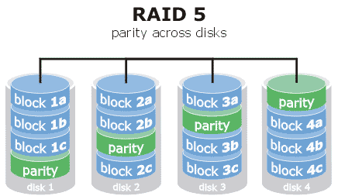
RAID
Hardware / Software / Semi-Hardware
Hot Spare disk
Hybrid RAID
RAID 10 = RAID 1 + RAID 0 (vs. RAID 01)
REF: http://www.prepressure.com/library/technology/raid

Slide 18
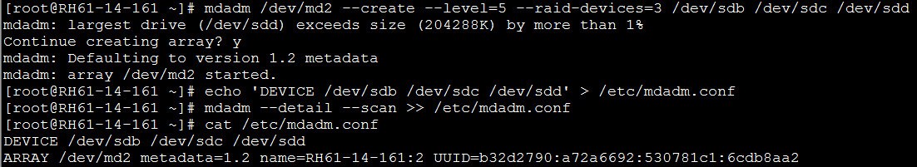
Create Software RAID
mdadm --create /dev/md# --level=(#|NAME) --raid-devices=# DEVICE [--spare-devices=# DEVICE]

Slide 19
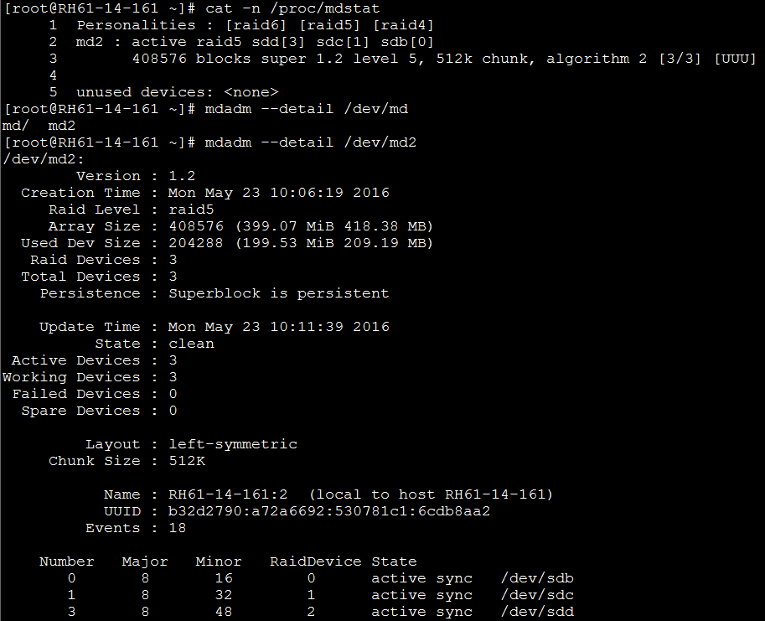
RAID status
cat -n /proc/mdstat
mdadm --detail /dev/md2

Slide 20
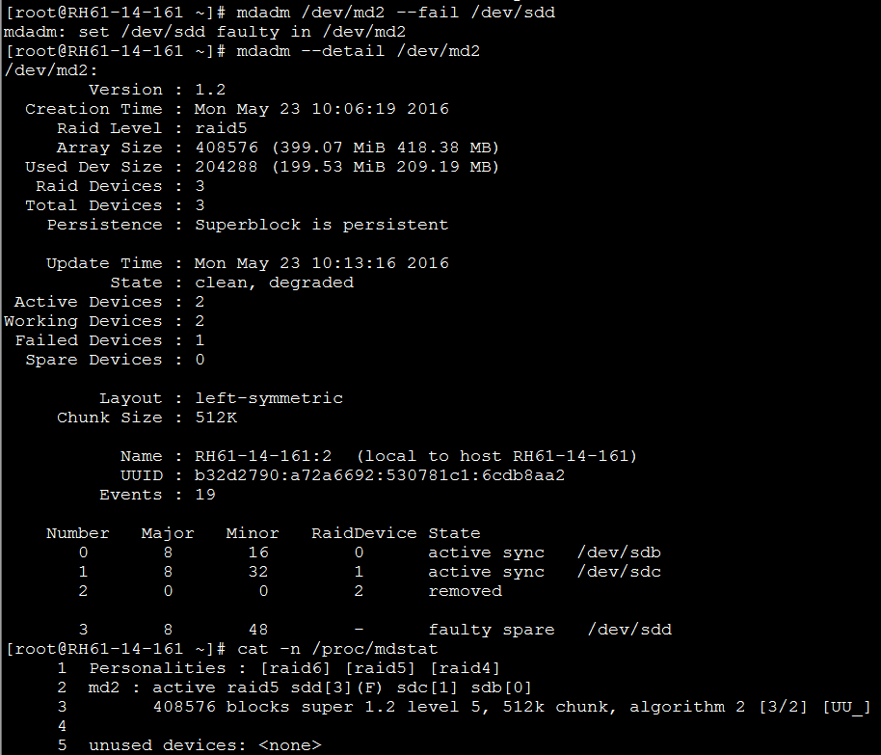
RAID failure and remove disk
mdadm /dev/md2 --fail /dev/sdd (--remove)

Slide 21
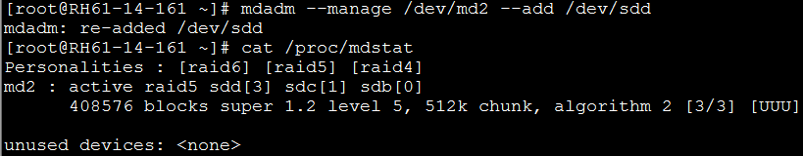

RAID allocate disk and size
mdadm --manage /dev/md2 --add /dev/sdd
mdadm /dev/md2 --stop /dev/md2
mdadm --assemble /dev/md2
mdadm --grow /dev/md2 --size=max
resize2fs /dev/md2

Slide 22
Create Hyprid-RAID
RAID 10, RAID 50, RAID 60
RAID 5
mdadm --create /dev/md0 --raid-devices=3 --level=5 /dev/sdb1 /dev/sdc1 /dev/sdd1
RAID 5
mdadm --create /dev/md1 --raid-devices=3 --level=5 /dev/sde1 /dev/sdf1 /dev/sdg1
RAID 50
mdadm --create /dev/md3 --raid-devices=2 --level=0 /dev/md0 /dev/md1

Slide 23
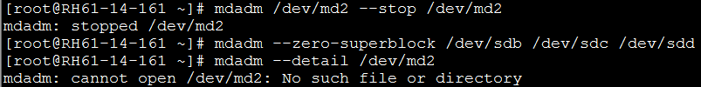
RAID remove
mdadm --zero-superblock /dev/sdb /dev/sdc /dev/sdd
rm /etc/mdadm.conf

